Slide 1
Control DC motor

Slide 2
Summary:
Interface a 5-pin analog joystick with an Arduino to control the direction of a DC motor via a motor driver.
The joystick sends analog signals to the Arduino.
Arduino reads the joystick position and decides how to move the motor(s).
The motor driver (L298N) takes commands from the Arduino and moves the DC motor accordingly.

Slide 3
Total Tasks
Set up the joystick & show output on serial monitor
Setting up a DC motor with Arduino Uno via Motor Driver
Directional control of DC motor using a Joystick
Control a DC motor’s direction using the joystick’s Y-axis, while using LEDs to visually indicate the direction based on joystick movement

Slide 4
🎮 5-Pin Thumb Joystick Module
small device that senses directional movement.
How far left/right you're pushing (X-axis)
How far up/down you're pushing (Y-axis)
Whether you’ve pressed the joystick down (like a button)

Slide 5
📌 Applications of This Module
Directional Control — move things like motors, cursors, robots, or characters in a game.
Motion Input — detect gestures or positional changes.
Button-Based Interaction — combine directional input with a click function.

Slide 6
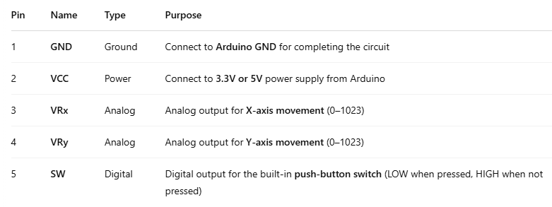
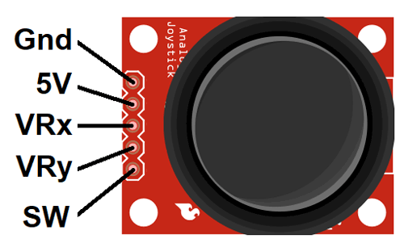
📌 5-Pin Thumb Joystick Module Pin Description

Slide 7
SW Pin
Inside the joystick, there’s a tiny push button underneath the stick - prevents floating signal.
When you push the joystick down (press it like a button):
The switch closes.
The SW pin sends a LOW (0V) signal to the Arduino.
When you release the joystick:
The switch opens.
The SW pin sends a HIGH (5V) signal (if connected with a pull-up resistor)

Slide 8
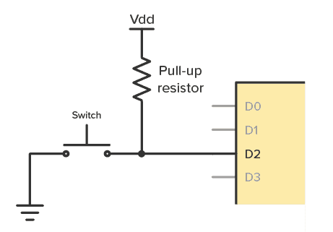

Slide 9
📊 Internal Functionality
Inside the joystick:
There are two potentiometers (variable resistors) — one for the X-axis and one for the Y-axis (VRx & VRy)
Provides 10 bit value (0-1023).
When you move the stick:
It changes the resistance of each potentiometer.
That resistance changes the voltage sent to the Arduino on VRx and VRy pins.
Arduino reads this voltage using analogRead()
When the joystick is centered (not pushed), both VRx and VRy give a value around 512 (middle of 0–1023).

Slide 10
1023
712
312
712
0
1023
512,512
312
0

Slide 11
Joystick Module Summary
A 5-pin joystick module uses two potentiometers for X and Y axes.
It outputs analog voltages (0–1023) based on joystick movement.
Has a digital switch (SW) for click detection.
The center position is around 512.

Slide 12
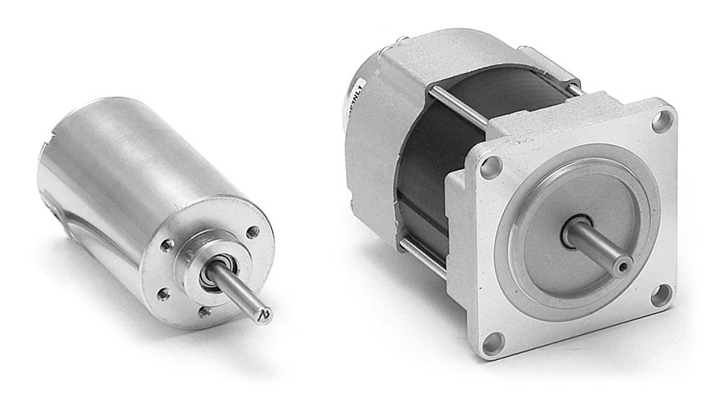
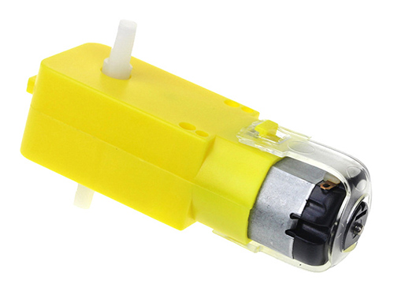
DC motor - Direct Current Motor
An electric motor that runs on direct current (DC),
The current flows in one direction.
The motor converts electrical energy
(from a power source like a battery) into
mechanical motion (rotation).

Slide 13
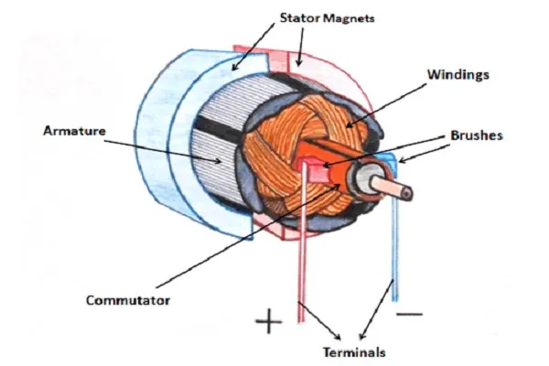
How Does a DC Motor Work?
At its core, a DC motor consists of two main parts:
Rotor (Armature): This is the rotating part of the motor,
often made of copper wire wound into coils.
Stator: This is the stationary part of the motor
that creates the magnetic field, either be made
with permanent magnets or electromagnetic coils.
When DC voltage is applied to the motor’s terminals (the positive and negative leads),electric current flows through the rotor’s windings, it generates a magnetic field. This field interacts with the magnetic field of the stator, creating a torque (rotational force) that makes the rotor spin.

Slide 14
Motor Spins Direction:
The direction of the motor's rotation depends on the direction of the current flowing through the armature.
If you swap the positive and negative connections
(the polarity of the voltage), the direction
of the current through the motor changes.
This causes the magnetic field to interact in the opposite direction,
making the motor spin in the opposite direction.

Slide 15
Speed and Torque of DC Motors:
Speed (RPM) & Torque:
The speed of the motor is proportional to the voltage applied to the motor.
Torque is the force that causes the motor to turn.
Higher voltage → More current → more torque → faster rotation.
Lower voltage → Less current → less torque → slower rotation.

Slide 16
How is a DC Motor Controlled?
Speed Control (Using PWM):
To control the speed of a DC motor, we use PWM (Pulse Width Modulation).
With PWM, we send a series of on/off pulses to the motor. The width of the “on” time (how long the motor is on) controls the speed.
The longer the motor is on, the faster it spins.
Direction Control (Using H-Bridge):
To reverse the direction of a DC motor, we use an H-bridge motor driver.
The motor can spin forwards or backwards depending on how the H-bridge switches the current flow.

Slide 17
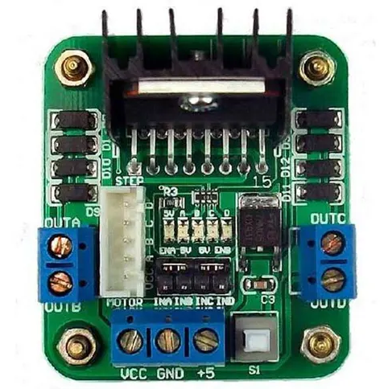
Motor Driver
An electronic module that acts as an interface between a microcontroller (like an Arduino or Raspberry Pi) and a motor.
Takes small control signals from the Arduino
Switches a higher-power motor supply on and off
Controls motor speed and direction safely

Slide 18
⚙️ L298N Motor Driver
dual H-bridge motor driver based on the L298N chip.
It can handle Up to 46V & Up to 2A per motor.
Dual H-bridge means:
It can control two DC motors independently
You can control both speed and direction for each motor

Slide 19
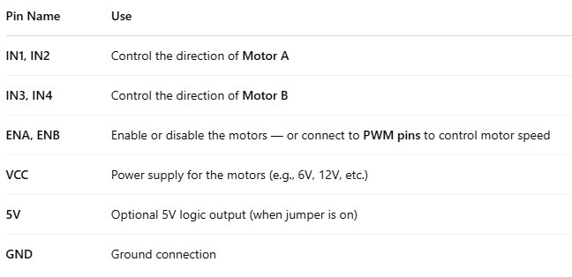
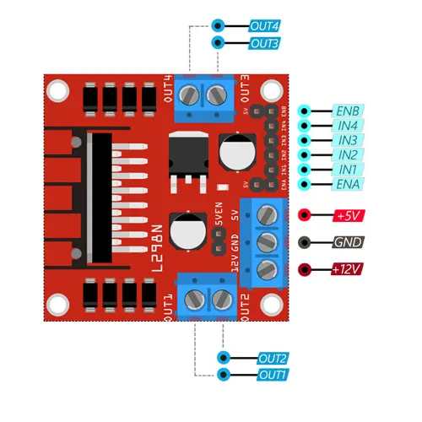
🔌 L298N Pins and Connections

Slide 20
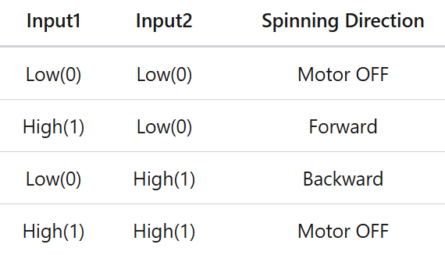
🔄 Motor Direction
Control the motor’s direction by setting pairs of control pins (IN1, IN2) to HIGH (1) or LOW (0).

Slide 21
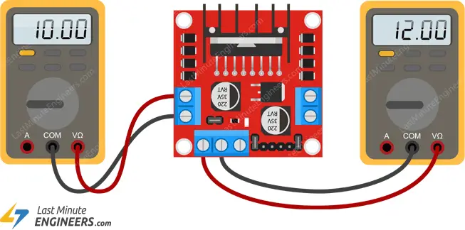
⚡ Voltage Drop
The L298N uses two transistors in series (inside the H-bridge) to control current flow. Thus, there’s a small voltage loss (called a voltage drop).
In the L298N, this drop is about 2V.So if you supply 12V to the L298N’s VCC pin, your motors will actually get around 10V.
If you have a 5V motor, supply 7V to the L298N.
If you have a 12V motor, supply 14V to the L298N.

Slide 22
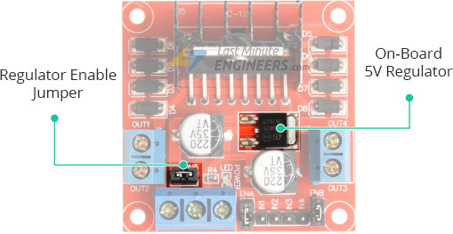
🔌 On-board 5V Regulator & Jumper
78M05 voltage regulator chip
It takes the motor’s power supply (VCC — like 12V)
Converts it to a clean 5V output
for use by Arduino or other 5V components
The Jumper:
When the jumper is placed, the regulator is enabled.
The 5V pin becomes an output (can use it to power your Arduino, sensors, etc.)
If you remove the jumper, you need to supply your own 5V logic voltage to the L298N’s 5V pin.
Note: Only use the onboard 5V regulator if your motor supply <= 12V (or it may overheat).
Do not connect 5V from Arduino to the driver’s 5V pin if the 5V regulator is in enabled & jumper is in place.

Slide 23
